Slide 1



mCaffiene Offer Insights
View in Power BI
Last data refresh:
7/25/2023 10:51:29 AM UTC
Downloaded at:
12/9/2023 8:30:04 AM UTC

Slide 2
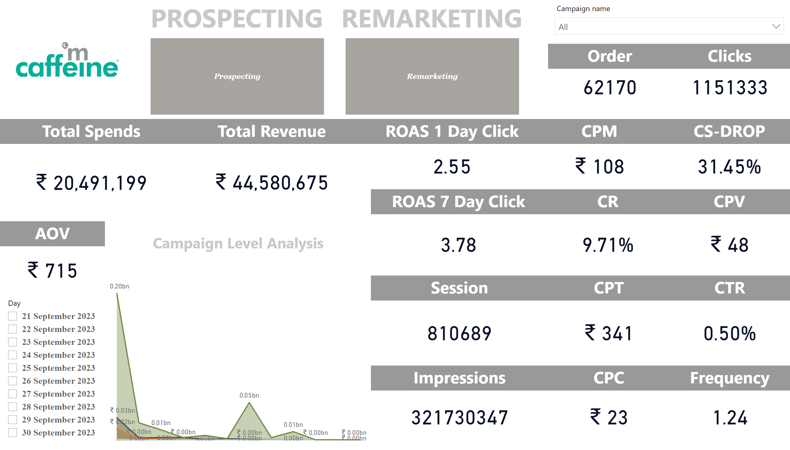

Slide 3
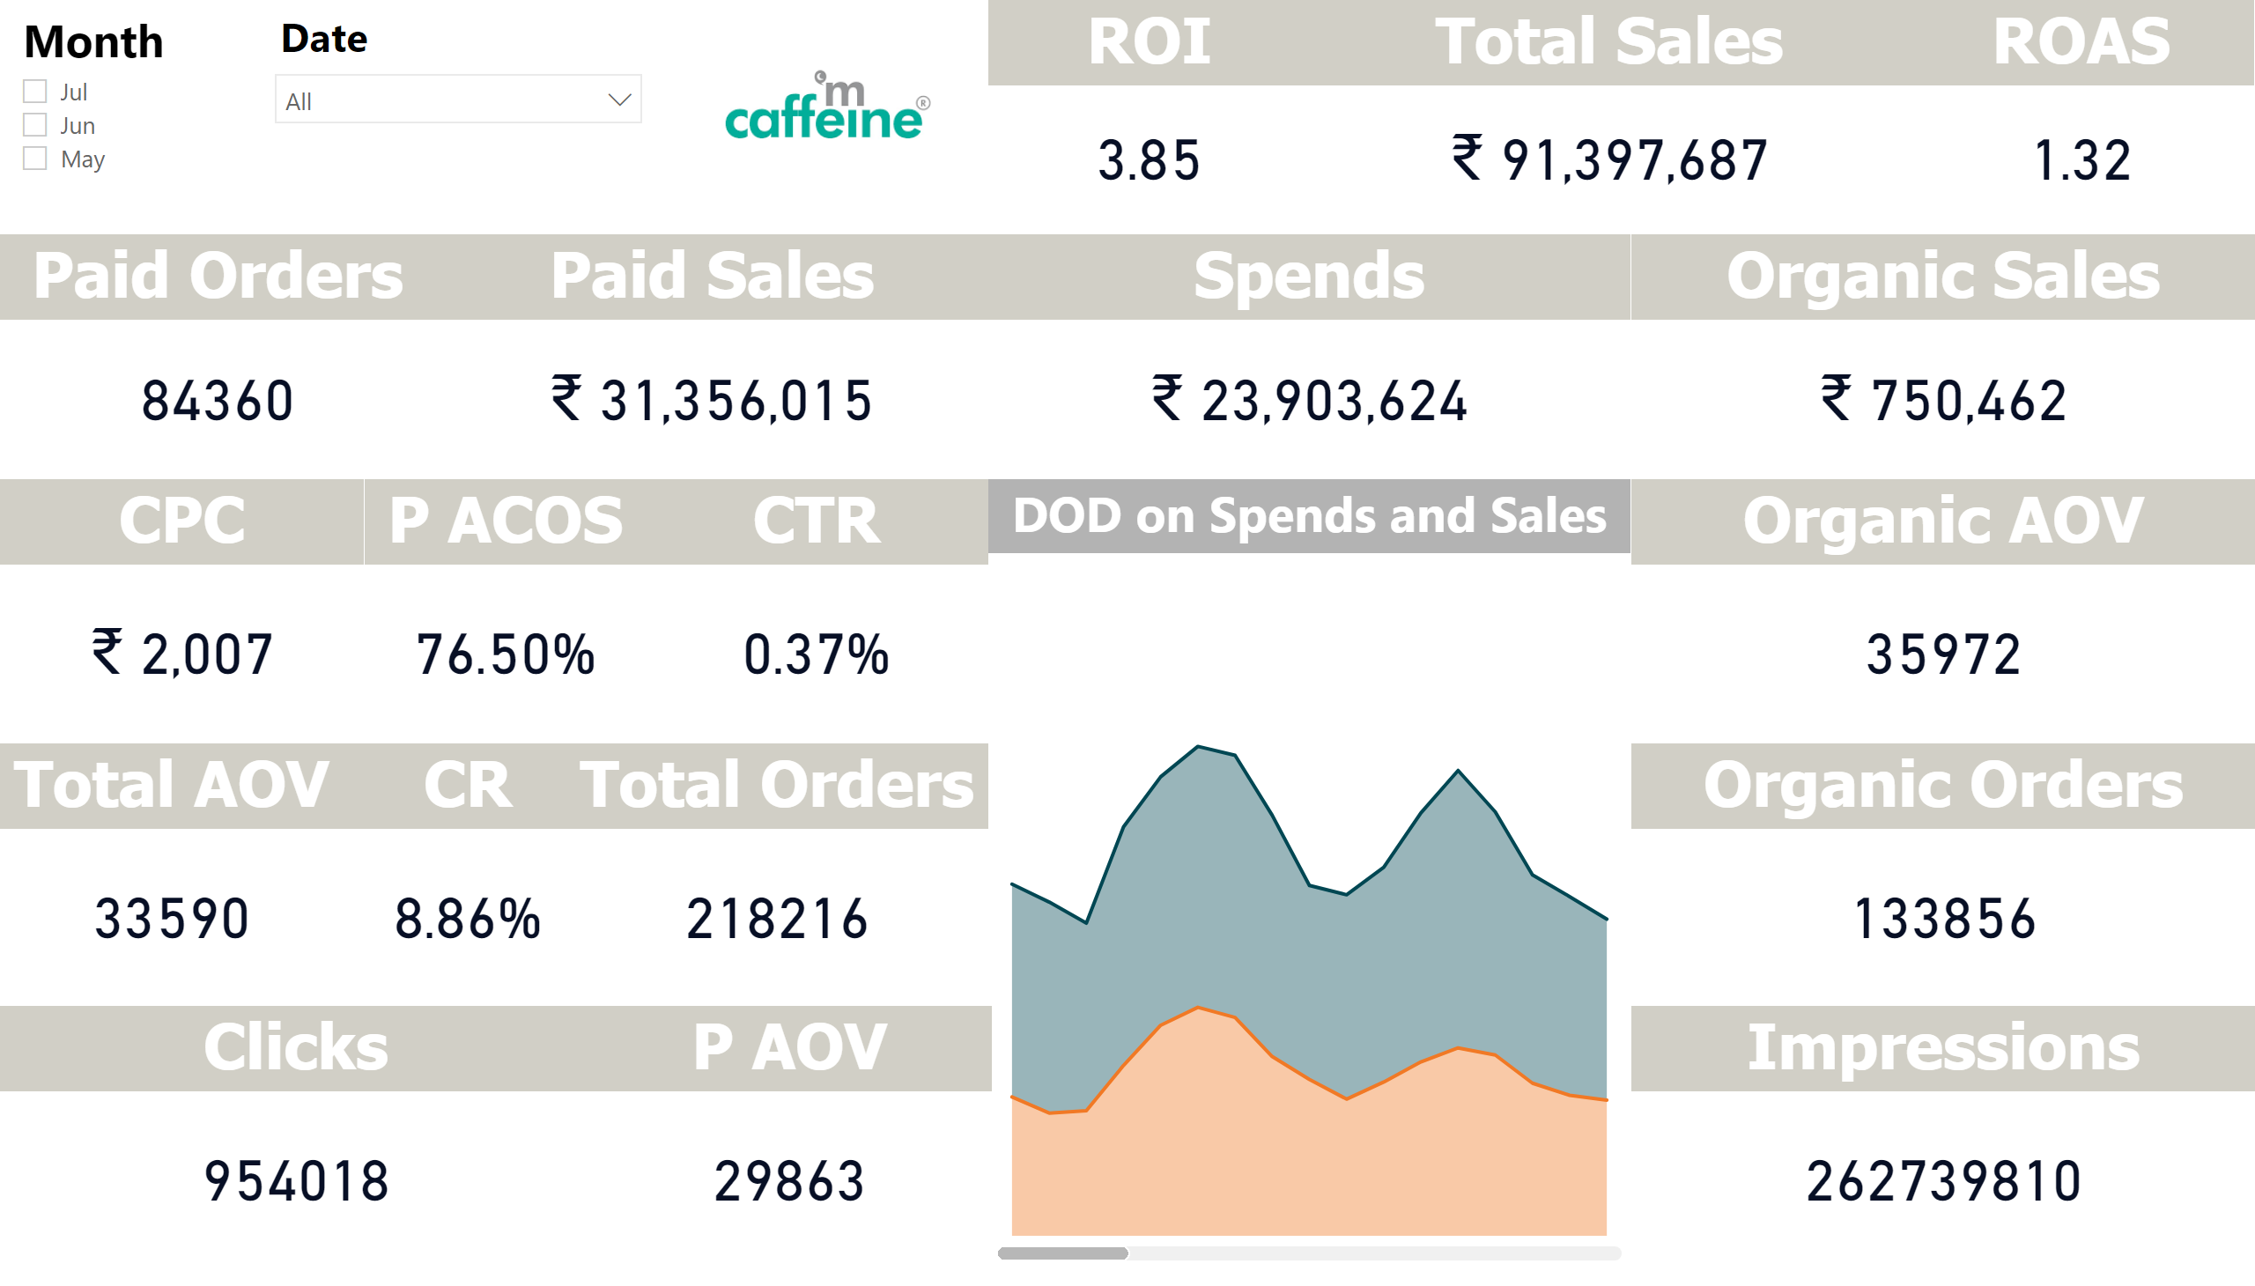
Page 1
Notes:
DOD on Spends and Sales
No alt text provided
Total Sales
No alt text provided
Paid Sales
No alt text provided
P AOV
No alt text provided
P ACOS
No alt text provided
Organic AOV
No alt text provided
Organic Sales
No alt text provided
Organic Orders
No alt text provided
ROAS
No alt text provided
Clicks
No alt text provided
CPC
No alt text provided
Paid Orders
No alt text provided
CTR
No alt text provided
CR
No alt text provided
Impressions
No alt text provided
ROI
No alt text provided
image
No alt text provided
slicer
No alt text provided
slicer
No alt text provided
Spends
No alt text provided
Total AOV
No alt text provided
Total Orders
No alt text provided

Slide 4
